Slide 1




Time Series Forecasting – Industry Case Study (Episode 2) 13th Nov, 2021 Anjana Agrawal

Slide 2

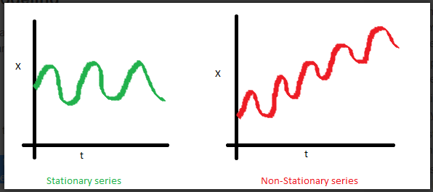
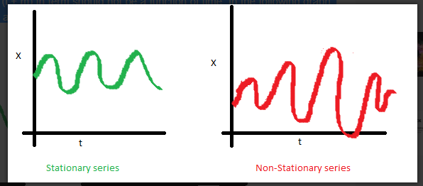
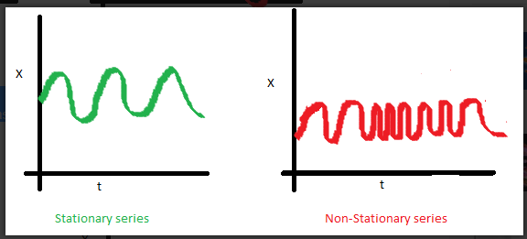
Time Series Characteristics
3 Characteristic for a STATIONARY Time Series
Mean is NOT a function of Time Variance is NOT a function of Time (Homoscedasticity)
Covariance is NOT a function of Time

Slide 3
Time Series Models
Case 1: level data
Simple Average
Moving Average
Simple Exponential Smoothing
Case 2: trend data
Linear Regression
Holt’s model (Double Exponential)
Case 3: seasonal data
Holt Winter’s model (Triple Exponential)

Slide 4
Time Series Models (Contd..)
Case 1: level data (Simple Exponential Smoothing)
For example, the demand for a product in last 6 years was as follows:
Different ways of forecasting the demand for 2018 could be:
Average: 27
Last few values (recent 4): 26.25
Weighted average of recent values (Weight % age as .50, .30 and .20 for last 3 values): 26.9
Average after removing outliers: 26
This can be represented as F = a + ε (since there is not observable trend)
Year | 2012 | 2013 | 2014 | 2015 | 2016 | 2017 | 2018
Demand | 25 | 32 | 24 | 28 | 26 | 27 | ?

Slide 5
Time Series Models (Contd..)
Simple average: Equal weightage to all data points.
Weighted average: Recent data points are given higher weights.
k-period moving average: Consider only recent data points, ignore the old ones.
k-period weighted moving average: Consider only recent data points, with weights assigned.

Slide 6
Time Series Models (Contd..)
Simple Exponential Smoothing
F_{t+1} = α D_{t} + (1 - α) F_{t}
where, F = Forecast, D = Demand, α = Smoothing Constant
Example:
Assume F₁=27 (simple average) and α = 0.2
F₂ = (0.2 * 25) + (0.8 * 27) = 26.6
F₃ = (0.2 * 32) + (0.8 * 26.6) = 27.68
F₄ = (0.2 * 24) + (0.8 * 27.68) = 26.94
F₅ = (0.2 * 28) + (0.8 * 26.94) = 27.16
F₆ = (0.2 * 26) + (0.8 * 27.16) = 26.92
F₇ = (0.2 * 27) + (0.8 * 26.92) = 26.94
Uses all the past values
If the demand is stable i.e. does not show much variation, we should have larger α.
When there is noise or variation in the data, we should have smaller α.

Slide 7
Time Series Models (Contd..)
Case 2: Trend Data (Holt’s Model)
F_{t+1} = a_{t} + b_{t}
where, F = Forecast, a = level (smoothed value), b = slope / trend of the line.
a_{t} and b_{t} are updated using exponential smoothing as:
a_{t} = α D_{t} + (1 - α) (a_{t-1} + b_{t-1})
b_{t} = β (a_{t} - a_{t-1}) + (1 - β) b_{t-1}
Slope and level are defined at each point.

Slide 8
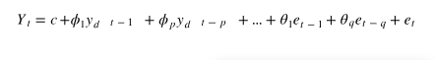
ARIMA
Auto-Regressive Integrated Moving Average
The process of fitting an ARIMA model is sometimes referred to as the Box-Jenkins method.
Specified by these three order parameters: (p, d, q)
Differencing, autoregressive, and moving average components make up a non-seasonal ARIMA model which can be written as a linear equation:
where y_{d} is Y differenced d times and c is a constant.

Slide 9
Time Series Models (Contd..)
Case 2: Trend +Seasonality(Holt Winters Model)
F_{t+1} = (a_{t} + b_{t}) * C_{t + 1}
where, F = Forecast, a = level (smoothed value), b = slope / trend of the line, c = seasonality
a_{t} ,b_{t} and c_{t} are updated using exponential smoothing as:
a_{t+1} = α (D_{t + 1} / c_{t + 1}) + (1 - α) (a_{t} + b_{t})
b_{t+1} = β (a_{t+1} - a_{t}) + (1 - β) b_{t}
c_{t+p+1} = γ (D_{t + 1} / a_{t + 1}) + (1 - γ) c_{t + 1}

Slide 10
SARIMA
SARIMA(p, q, d)(P, Q, D)_{m}
SARIMA(P, Q, D)_{m}: m is the seasonal factor. It’s the number of time steps for a single seasonal period.

Slide 11
Goodness of Forecast
Mean absolute deviation (MAD)
Mean squared deviation (MSD)
Mean percent deviation (MPD)
Example:
Consider 4 numbers: 30, 32, 31, 30.
The simplest forecast using mean of the numbers would be 30.75
MAD = (| 30 – 30.75 | + | 32 – 30.75 | + | 31 – 30.75 | + | 30 – 30.75 |) / 4 = (0.75 + 1.25 + 0.25 + 0.75)/4 = ¾ = 0.75
MSD = ((30 – 30.75)² + (32 – 30.75)² + (31 – 30.75)² + (30 – 30.75)² )/ 4 = (0.5625 + 1.5625 + 0.0625 + 0.5625 )/ 4= 2.75 / 4 = 0.6875
MPD = ((0.75 / 30.75) + (1.25 / 30.75) + (0.25 / 30.75) + (0.75 / 30.75) )*100/4 = (0.0244 + 0.041 + 0.008 + 0.0244) = 0.61

Slide 12
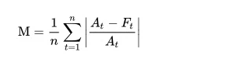
Goodness of Forecast
Mean absolute deviation (MAPE)
Where:
n is the number of fitted points,
A_{t} is the actual value,
F_{t} is the forecast value.
Σ is summation notation (the absolute value is summed for every forecasted point in time).
Root Mean Square Error (RMSE)

Slide 13
Case Study

Slide 14
Case Study – Part I
Business Problem:
We all know that blood is really important for health care. We have seen many blood donation camps and almost all of us have helped them to raise blood in the blood bank.
A blood unit has a shelf life of 42 days only, that means if blood is not used within 42 days then it will be a waste, also shortage of the blood also increases many risky situations; hence, hospitals always have this problem in hand.” How much blood do they have to store..?”

Slide 15
Case Study – Part I (Contd..)
Let's explore the data in reference to following hypothesis
Is there a variation in the blood requirement for a specific month ?? Is this variation same for all blood types.
Has the above mentioned pattern changed over a period of time for all blood types.
Can average be considered as a good statistical measure to guesstimate the future requirement for different blood types.
Is there a consistent increase/decrease in the usage pattern for all blood types. Is this pattern additive or multiplicative.

Slide 16
Case Study – Part II (Contd..)
Model Building (Steps)
Build various exponential smoothing models ,regression, naïve forecast models, simple average models etc. on the training data using multiple parameters and check the performance on the test data using MAPE and RMSE.
What are the pre-processing steps required for the given dataset (like imputation of missing values, check if the data is stationary or not etc.)
Build an automated version of the ARIMA/SARIMA model in which the parameters are selected using the lowest Akaike Information Criteria (AIC) on the training data and evaluate this model on the test data using RMSE.
Build ARIMA/SARIMA models based on the cut-off points of ACF and PACF on the training data and evaluate this model on the test data using RMSE .
Based on the model-building exercise, build the most optimum model(s) on the complete data and predict 12 months into the future with appropriate confidence intervals/bands.

Slide 17


HAPPY LEARNING

